Slide 1



UMD 5th Annual Datathon
NBA Expansion: Plan for Tomorrow’s Champions
Code Crushers

Slide 2

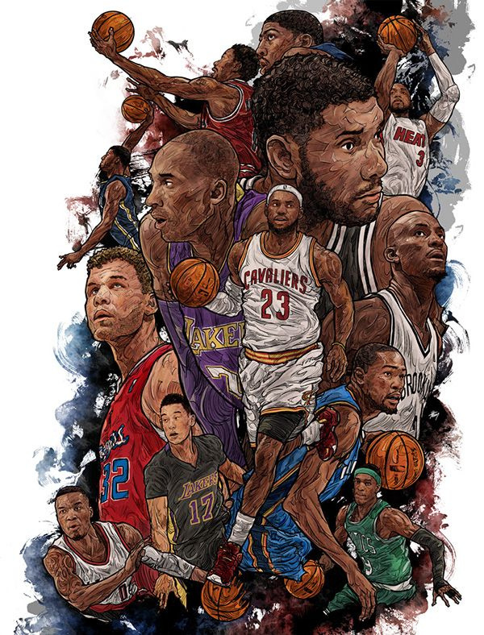

The NBA is considering adding new teams to its league
Goal: Target lucrative markets comprising young people, middle/upper-class demographics, and touristic areas
Challenge: Selecting the best cities
Goal: Using current NBA teams with similar market size - breakeven in 22 years
Key Questions:
What weighted criteria?
How to estimate the financial viability of each location?
How to grow the fanbase?

Slide 3


City Selection Analysis

Slide 4
How do we plan on shortlisting the cities?
Market Size
Culture and Infrastructure
Can the city form a sizable fan base?
Does the city have an existing sporting culture and infrastructure?
Age
Diversity
How young should the fan base be?
Is diversity important for the fan base representation?
Prosperity
Affordability
What does the economic strength of the city look like?
Can the general population afford to commute and buy tickets?

Slide 5
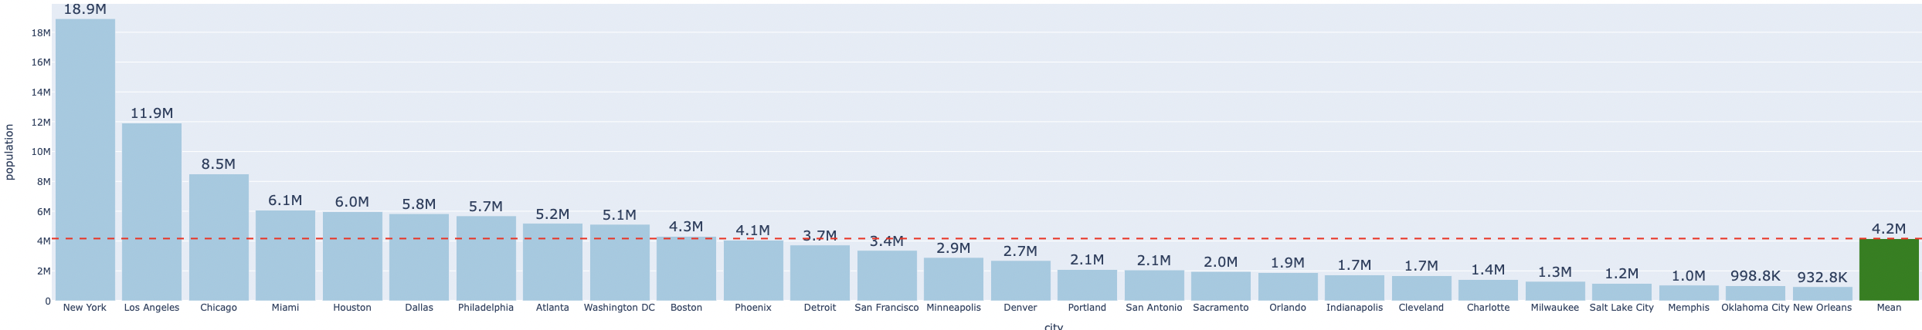
Assessing Market Size: Using New Orleans as threshold
Cities with large populations help create large fan bases
Use the least populated city as our cut off to narrow down the search

Slide 6
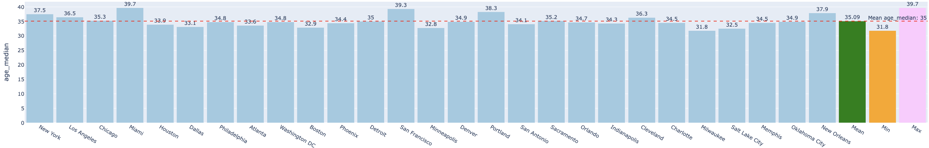
Selecting Cities with a Younger Demographic
30 - 40
Is the Age Median for NBA Cities
Target cities with a median age below 40 to ensure fans can afford and energetically engage with ticket purchases

Slide 7
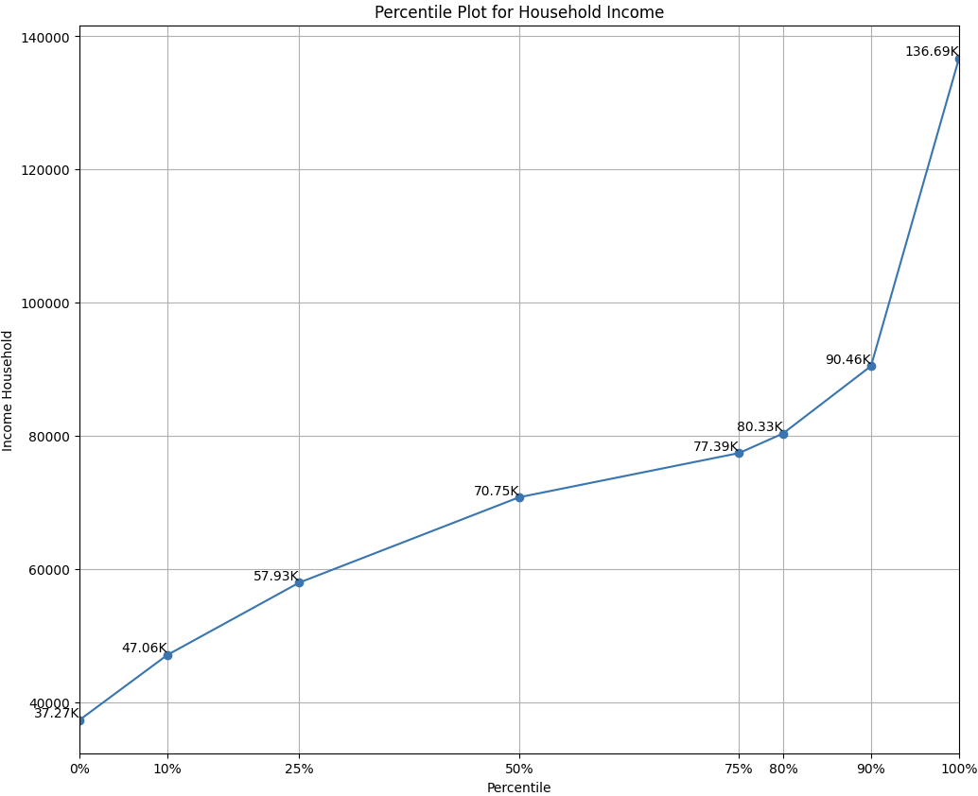
Unveiling Economic Prosperity Through 10th Percentile Household Income
90%
of the NBA Cities have an Household income median above $48,000

Slide 8
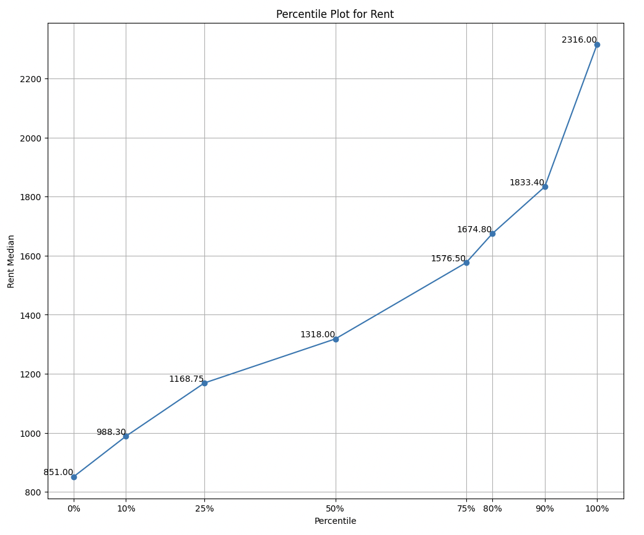
Affordability: Evaluating purchasing power with rent as the parameter
90%
of the NBA Cities were able to at least have a Rent median of $988

Slide 9
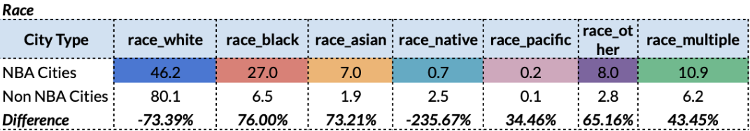
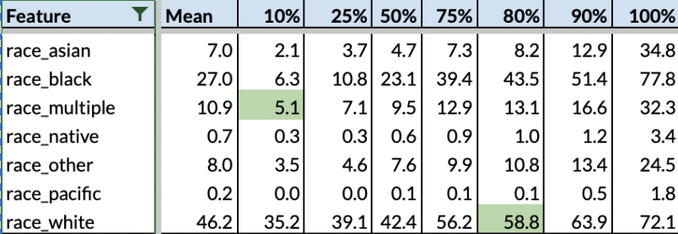
Diversity: Percentile Analysis of White Race & Multiple Ethnicities
Average Distribution of Race​ for NBA Cities & Non-NBA Cities
Percentile Distribution of Race for NBA Cities

Slide 10
Diversity: Percentile Analysis of White Race & Multiple Ethnicities
Average Distribution of Race​ for NBA Cities & Non-NBA Cities
Percentile Distribution of Race for NBA Cities

Slide 11
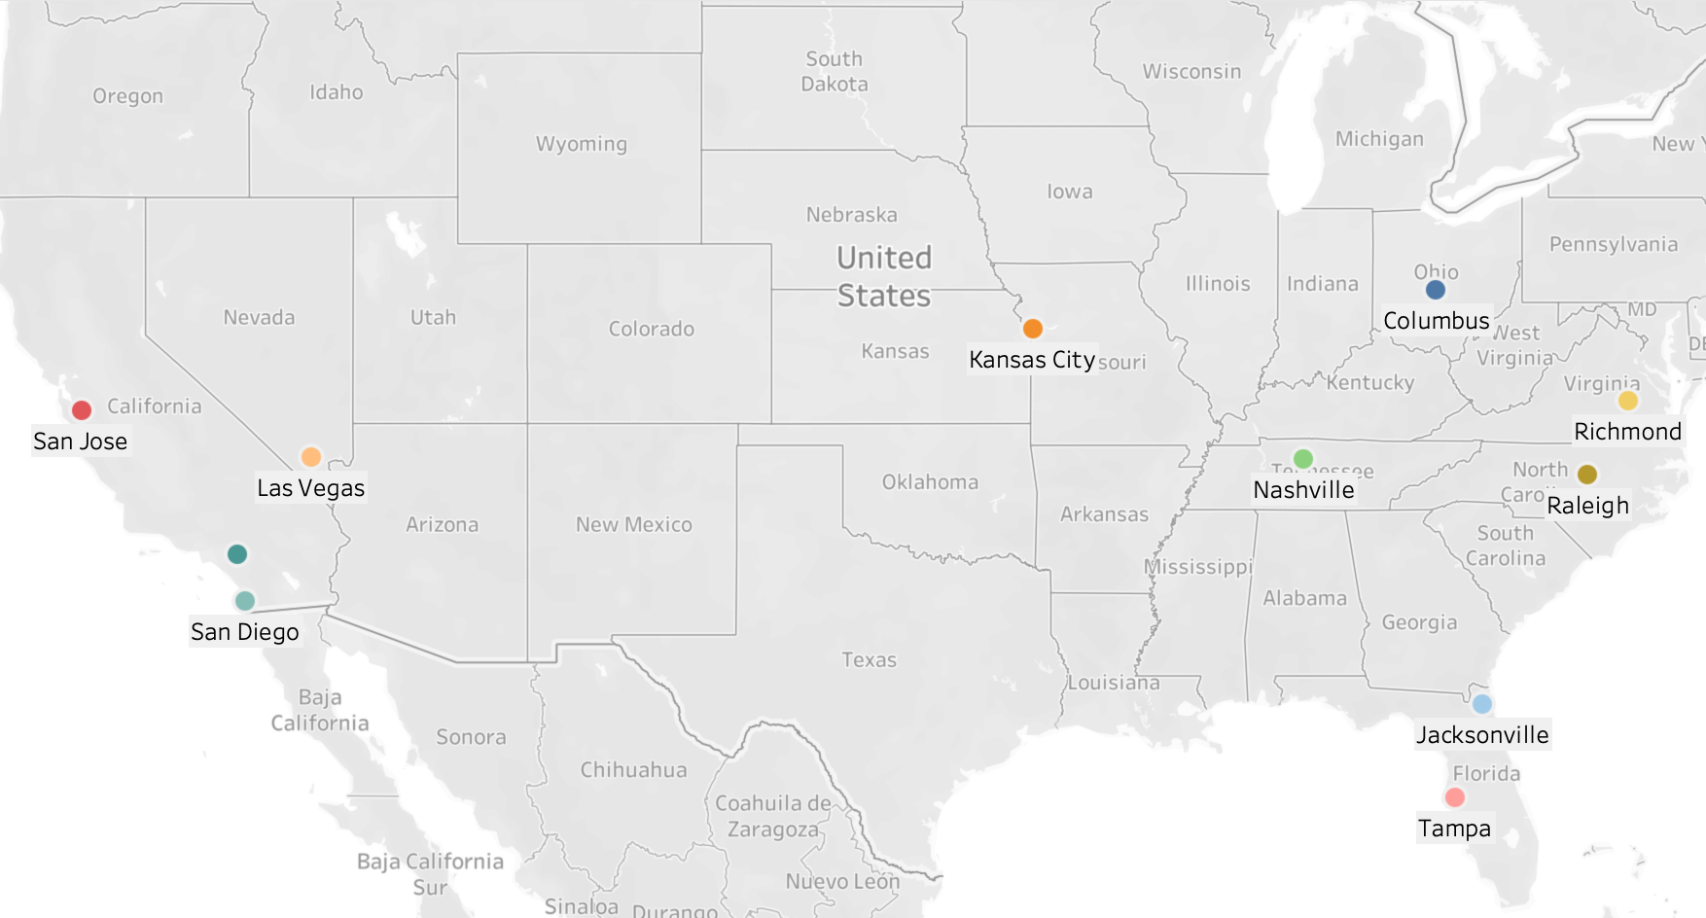
Shortlisted 11 Cities

Slide 12
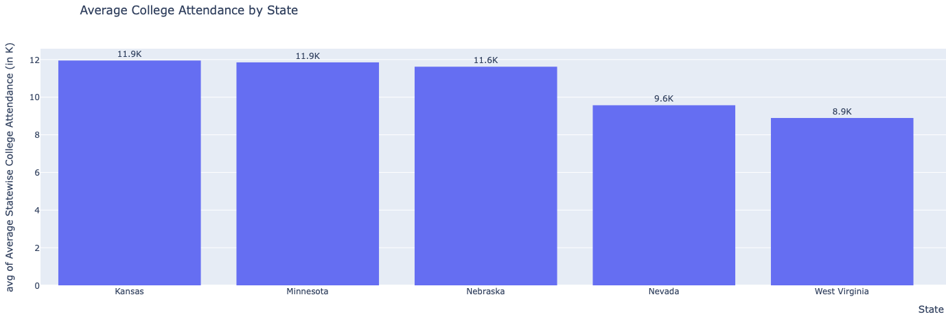
Culture : Bridging the NBA With College Basketball Craze
Top 5 US states with most average college attendance
Source: Statcrunch

Slide 13
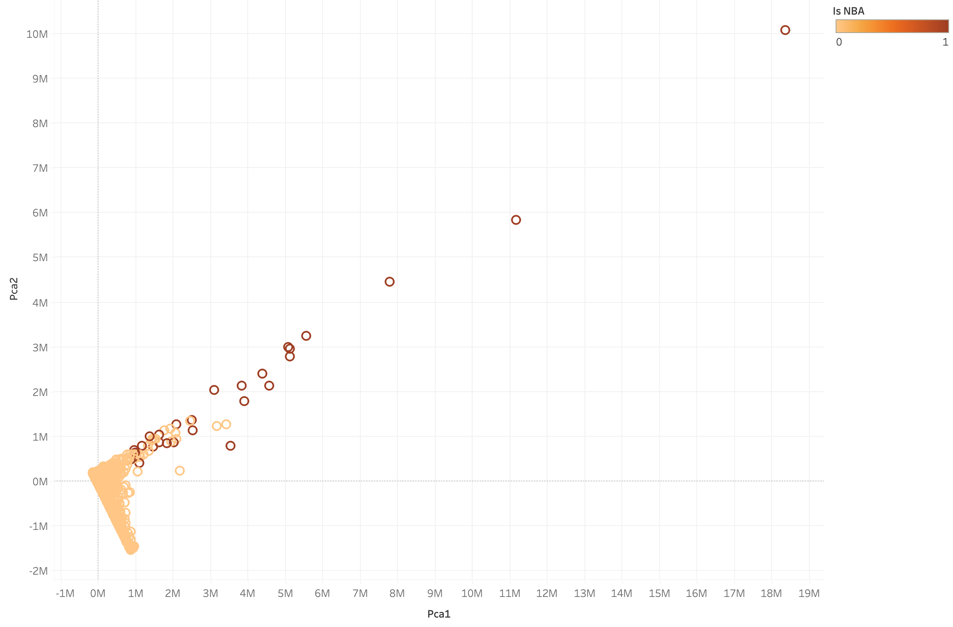
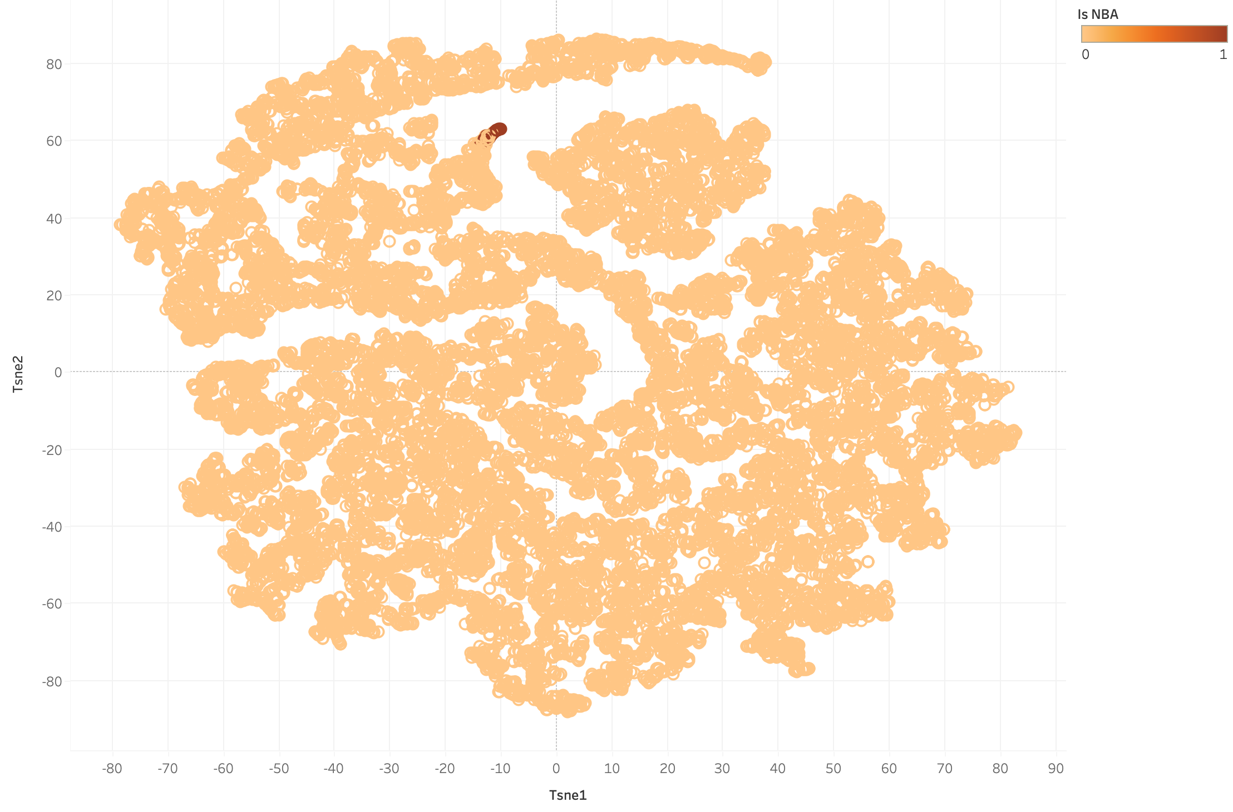
Clustering cities through Machine Learning (Parallel Analysis)
Cities with similar patterns are clustered closer to each other
The top 'n' nearest average distances from Non-NBA cities through all NBA cities could be potential cities for the expansion
Using PCA
Using TSNE

Slide 14
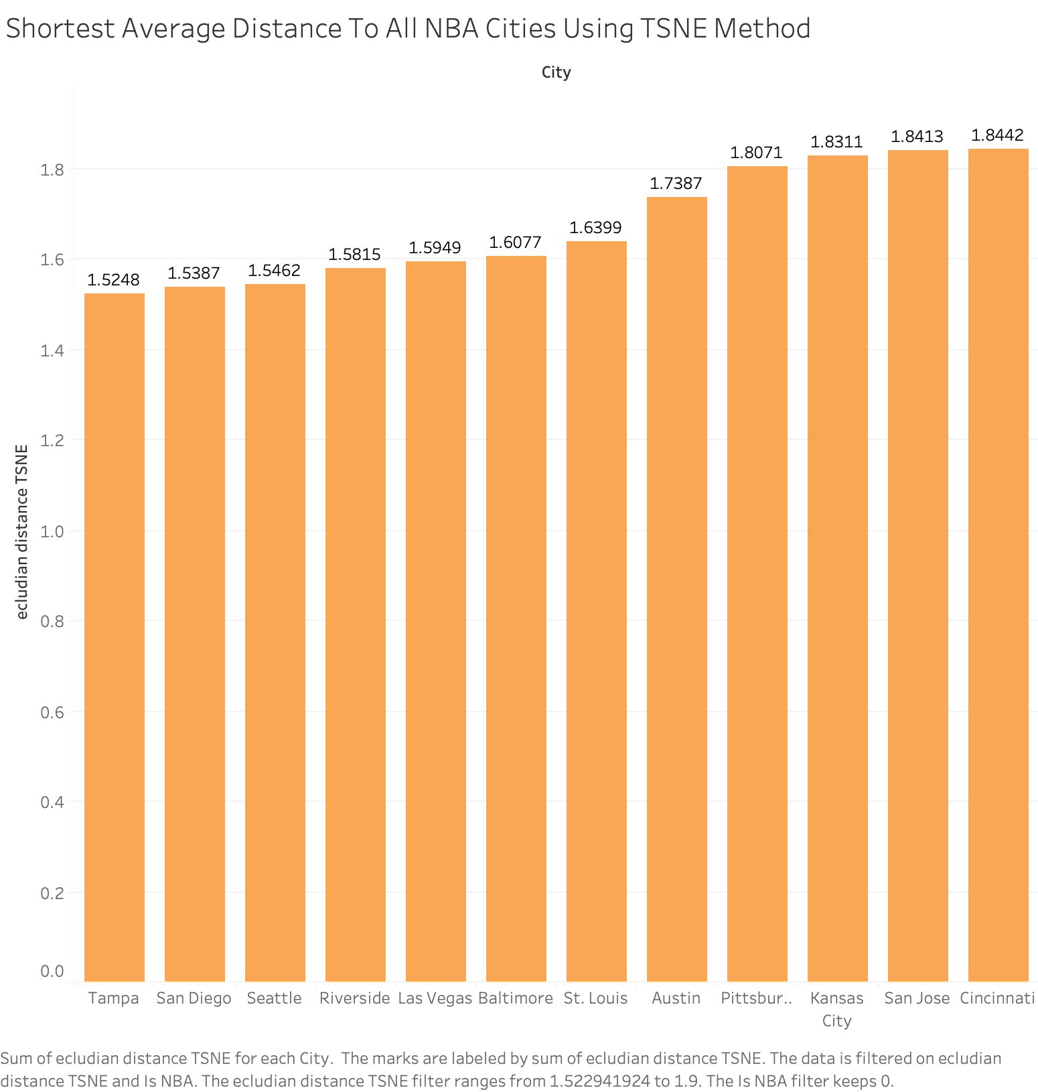
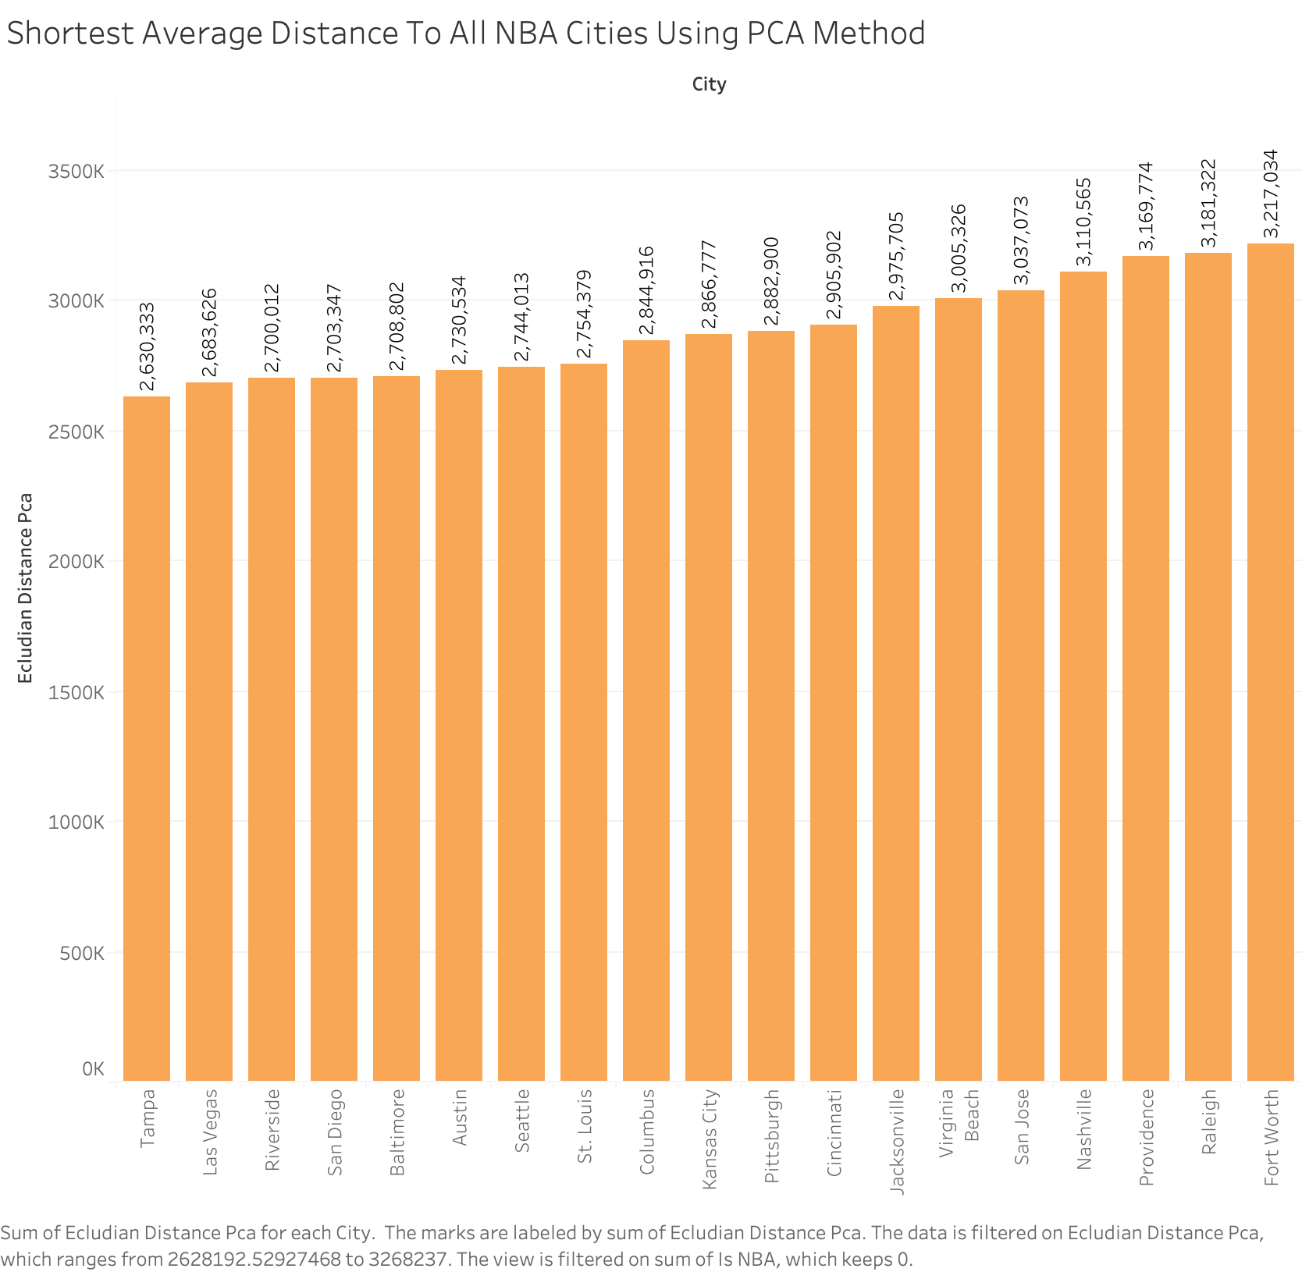
Potential cities with nearest average distance to NBA cities

Slide 15
Shortlisting Teams
Population > 932,759 | Age Median <40 | Household Income Median >48,000 | Rent Median >1000 | Poverty <20 | Race Multiple >5 and White <58.8 | Culture & Infrastructure+ Machine Learning Evaluation
26 Cities | 22 Cities | 20 Cities | 18 Cities | 17 Cities | 11 Cities | 2 Cities

Slide 16
Shortlisting Teams
Population > 932,759 | Age Median <40 | Household Income Median >48,000 | Rent Median >1000 | Poverty <20 | Race Multiple >5 and White <58.8 | Culture & Infrastructure+ Machine Learning Evaluation
26 Cities | 22 Cities | 20 Cities | 18 Cities | 17 Cities | 11 Cities | 2 Cities

Slide 17
Shortlisting Teams
Population > 932,759 | Age Median <40 | Household Income Median >48,000 | Rent Median >1000 | Poverty <20 | Race Multiple >5 and White <58.8 | Culture & Infrastructure+ Machine Learning Evaluation
26 Cities | 22 Cities | 20 Cities | 18 Cities | 17 Cities | 11 Cities | 2 Cities

Slide 18
Shortlisting Teams
Population > 932,759 | Age Median <40 | Household Income Median >48,000 | Rent Median >1000 | Poverty <20 | Race Multiple >5 and White <58.8 | Culture & Infrastructure+ Machine Learning Evaluation
26 Cities | 22 Cities | 20 Cities | 18 Cities | 17 Cities | 11 Cities | 2 Cities

Slide 19
Shortlisting Teams
Population > 932,759 | Age Median <40 | Household Income Median >48,000 | Rent Median >1000 | Poverty <20 | Race Multiple >5 and White <58.8 | Culture & Infrastructure+ Machine Learning Evaluation
26 Cities | 22 Cities | 20 Cities | 18 Cities | 17 Cities | 11 Cities | 2 Cities

Slide 20
Shortlisting Teams
Population > 932,759 | Age Median <40 | Household Income Median >48,000 | Rent Median >1000 | Poverty <20 | Race Multiple >5 and White <58.8 | Culture & Infrastructure+ Machine Learning Evaluation
26 Cities | 22 Cities | 20 Cities | 18 Cities | 17 Cities | 11 Cities | 2 Cities

Slide 21
Shortlisting Teams
Population > 932,759 | Age Median <40 | Household Income Median >48,000 | Rent Median >1000 | Poverty <20 | Race Multiple >5 and White <58.8 | Culture & Infrastructure+ Machine Learning Evaluation
26 Cities | 22 Cities | 20 Cities | 18 Cities | 17 Cities | 11 Cities | 2 Cities

Slide 22

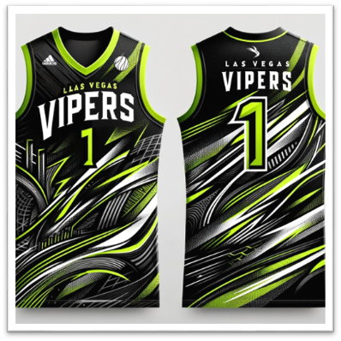
Las Vegas Vipers

Slide 23
Marketing and Financial Analysis

Slide 24
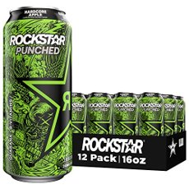



Sponsor Analysis
Las Vegas T-Mobile Arena
All-Net Resort and Arena
Future partnership to provide 5G ANS
Headquarters in Las Vegas
70 sponsorship deals during the NFL Draft in 2022
Located near the T-Mobile Arena
Potential hotel deals for fans

Slide 25
Personalized Marketing Strategy
Social Media
01
Community & Fan Engagement
Partner with Las Vegas celebrities to promote the team on Instagram and TikTok
02
Las Vegas themed pre-season games
Las Vegas Vipers players participate in the NBA’s summer league in Las Vegas
04
Hometown NBA Hero
AI Driven Personalization
03
Local retired NBA players as brand ambassadors
Fan of the month – NBA loyalty rewards program
Use AI for personalized fan communication and promotional offers

Slide 26
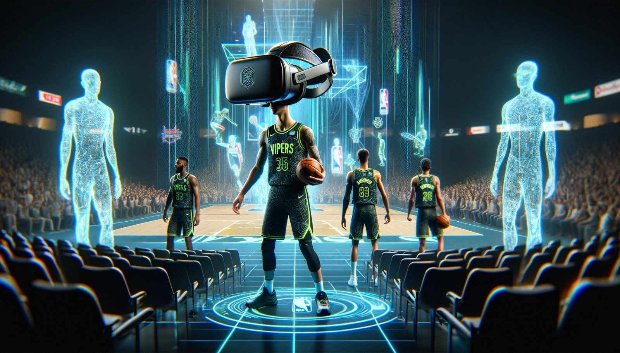
Virtual Reality: Dunk Into Tomorrow

Slide 27
Cost Breakdown

Slide 28
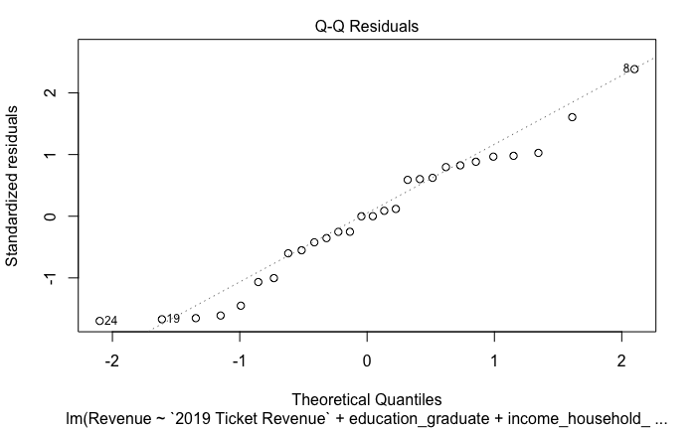
Revenue Based on Regression
Model evaluation
The independent variables are explaining the variability of revenue by 97.10%
The variables in the models statistically significant with p-values less than 0.05
The residuals are normally distributed
Ticket Sales for Las Vegas: (Ticket price(200) * seating(20000) *home games(41)) * 0.70= $114.8M
The revenue of Las Vegas with fitting the demographic data with estimated ticket sales is given as $365.65M

Slide 29
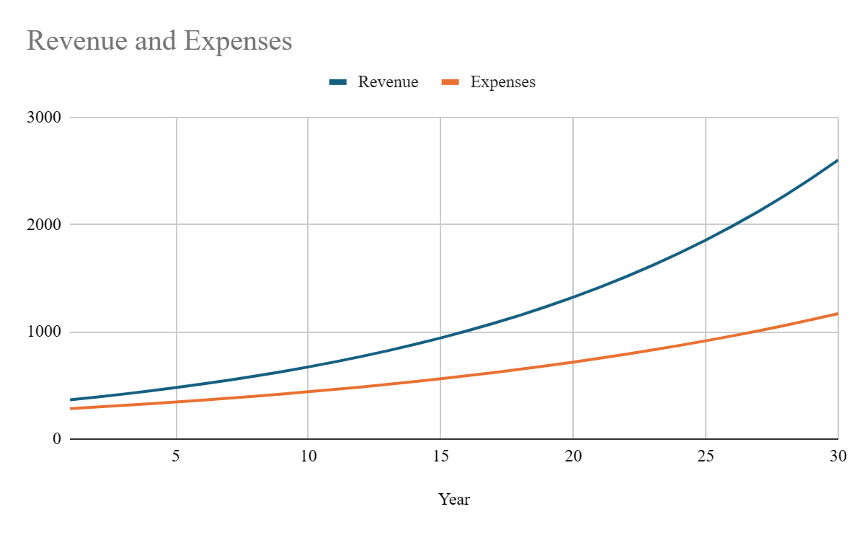
Breakeven Position
22 Years
7% annual revenue growth rate
5% annual expense growth rate
Capital Expenditure $2.5B (due to expansion fee)

Slide 30
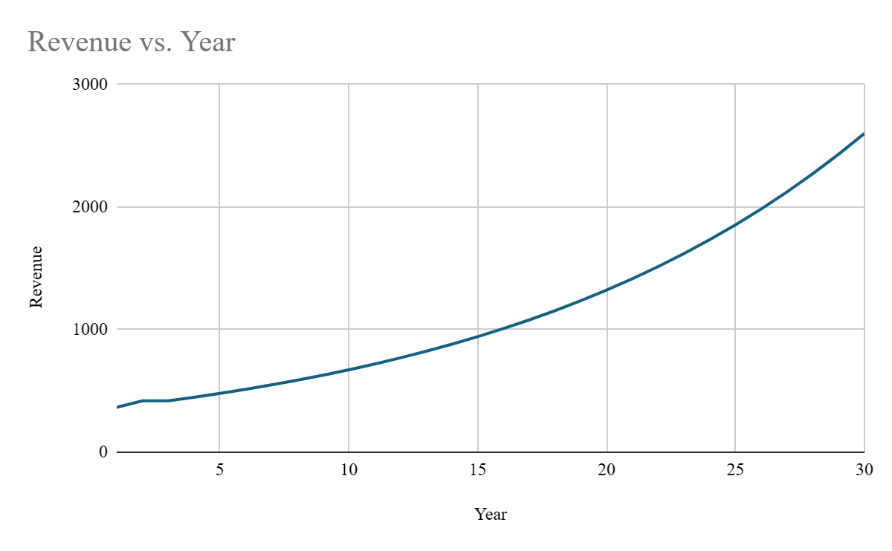
Revenue for Year n = 365.5×(1.07)^(n-1)
How much money will Vegas Vipers make in 30 Years?
$2.6B

Slide 31
International Expansion

Slide 32
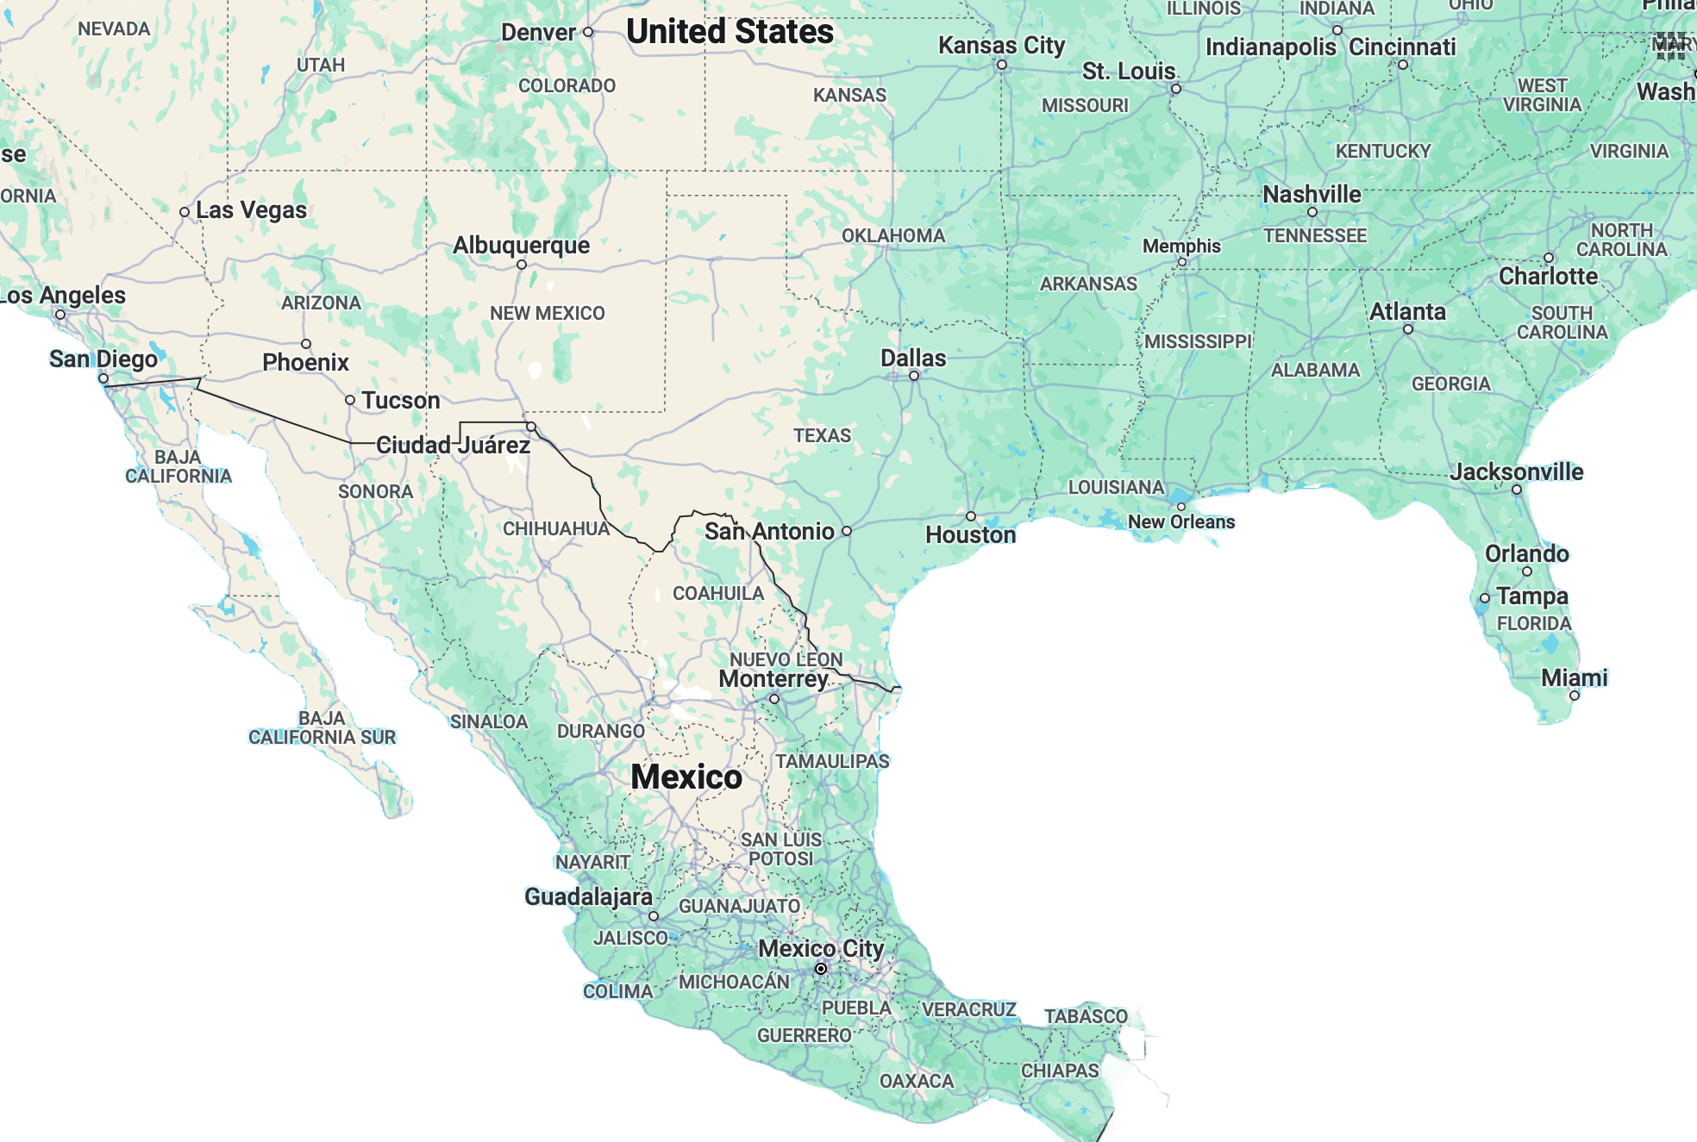
Why Mexico?
Expansion Criteria
Growing GDP
Safety
Current NBA players
Minimal Time Difference
Mexico City
Notes:
Las Vegas (LV) to Mexico City:
Flight distance: Approximately 1,700 miles.
Time difference: Usually 2 hours behind Mexico City (considering standard time zones).
Tampa to Mexico City:
Flight distance: Around 1,200 miles.
Time difference: Typically 1 hour behind Mexico City (based on standard time zones).

Slide 33
NBA's Most International Games Have been hosted in Mexico
During the 2022-23 season in Mexico:
Social media interactions across all NBA Mexican accounts increased by 90%
NBA ESPN viewership increased by 25%
Mexico ranks in the Top 10 of all international markets in NBA League Pass subscriptions

Slide 34
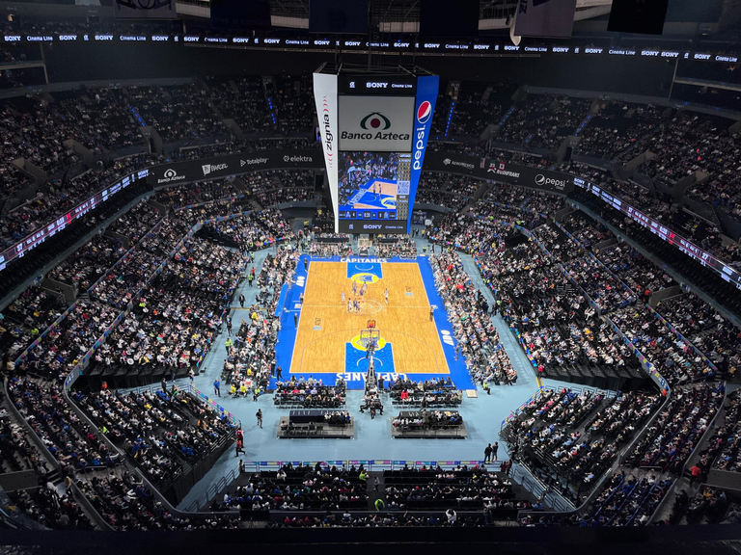
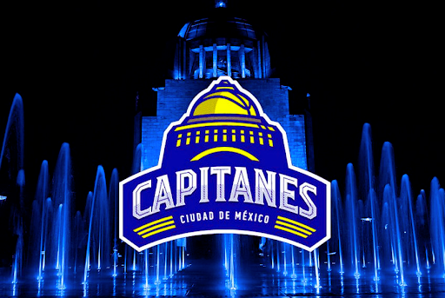
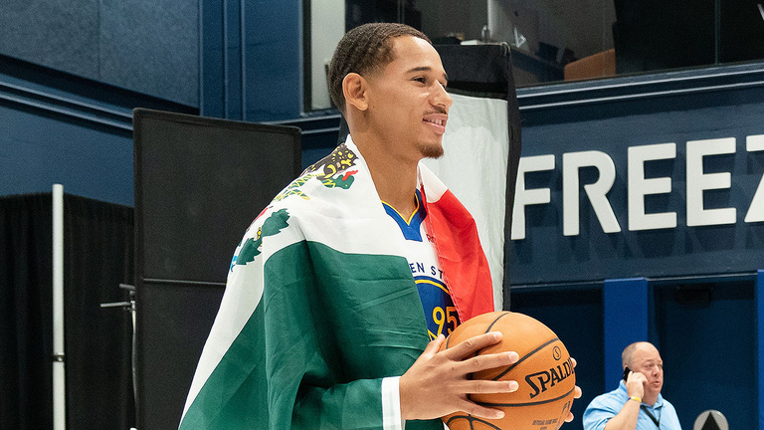
No Extra Capital For an Arena
1
2
3
CAPACITY
CAPITANES
MEXICAN NBA PLAYERS
Mexico 22,300 people vs. Memphis Grizzlies 19,000 people
Mexico’s G – League increased fan interest in the NBA – Spanish content
Mexico has multiple NBA players in other teams - cultural connection

Slide 35
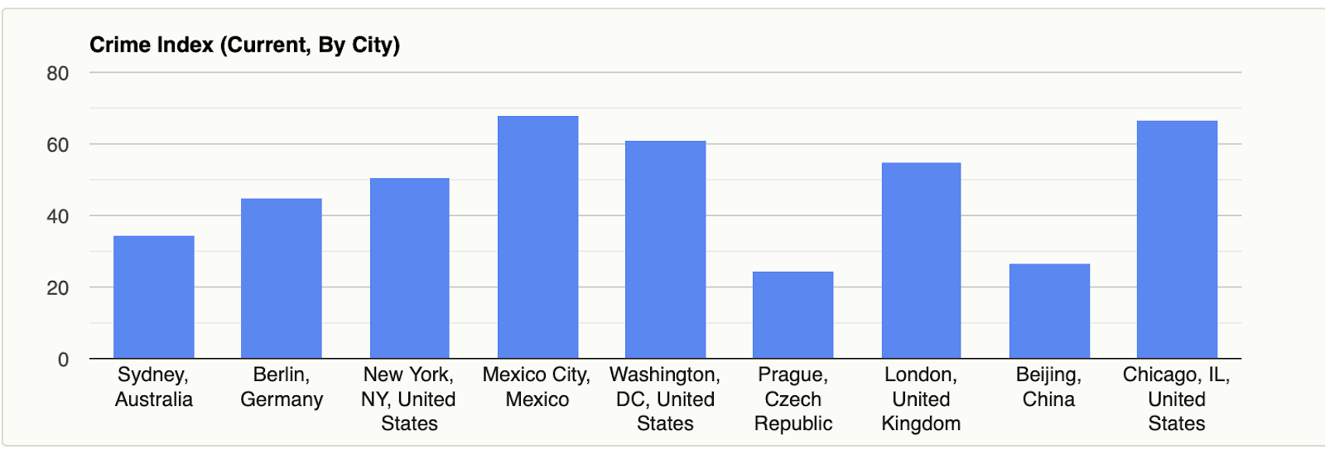
Mexico City has the same crime rate as Chicago

Slide 36

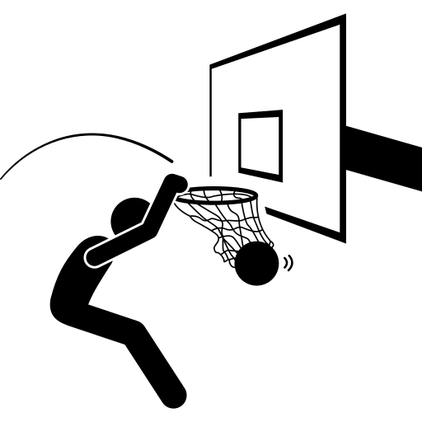
Looking ahead, a next-gen NBA experience in Las Vegas
Current State
Future Target
….to become a Las Vegas franchise powerhouse, setting new standards in fan engagement
A strong product….
…with greater relevance…
NBA has a dynamic product, but beyond an existing loyal fan base, there’s opportunity to broaden its reach in an untapped market
Bringing in new global fans onto the court and maximizing the value from their existing fans
Data-driven and personalized marketing strategies

Slide 37
Thank You!

Slide 38
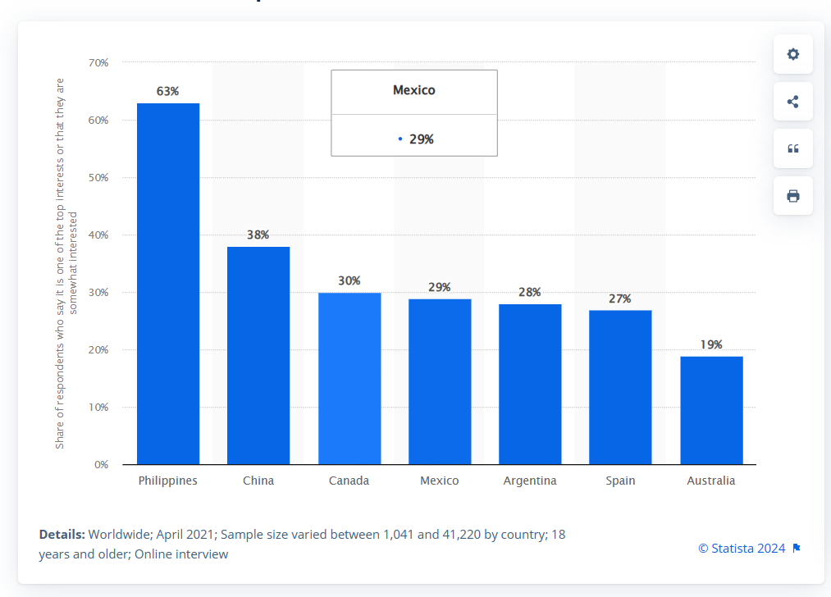
Appendices
Global Interest in NBA :Global interest in the NBA 2021 | Statista

Slide 39
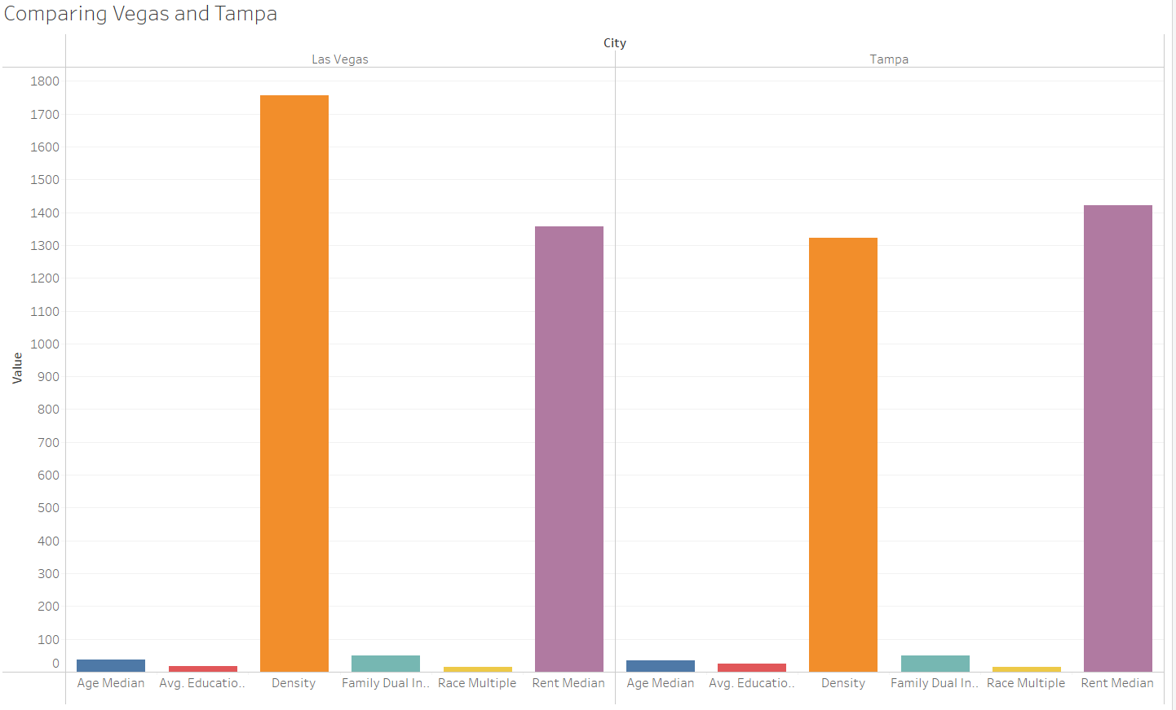
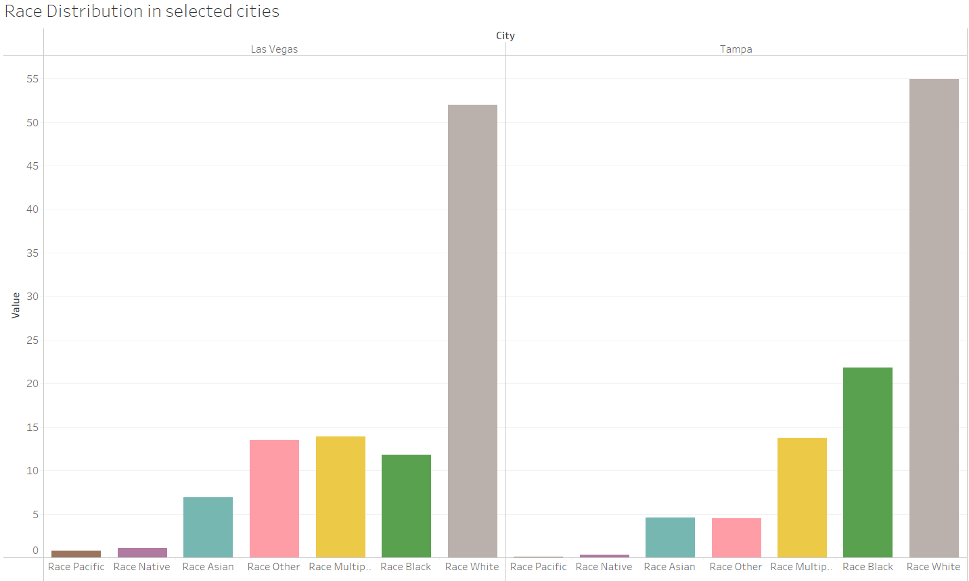
Vegas vs. Tampa

Slide 40
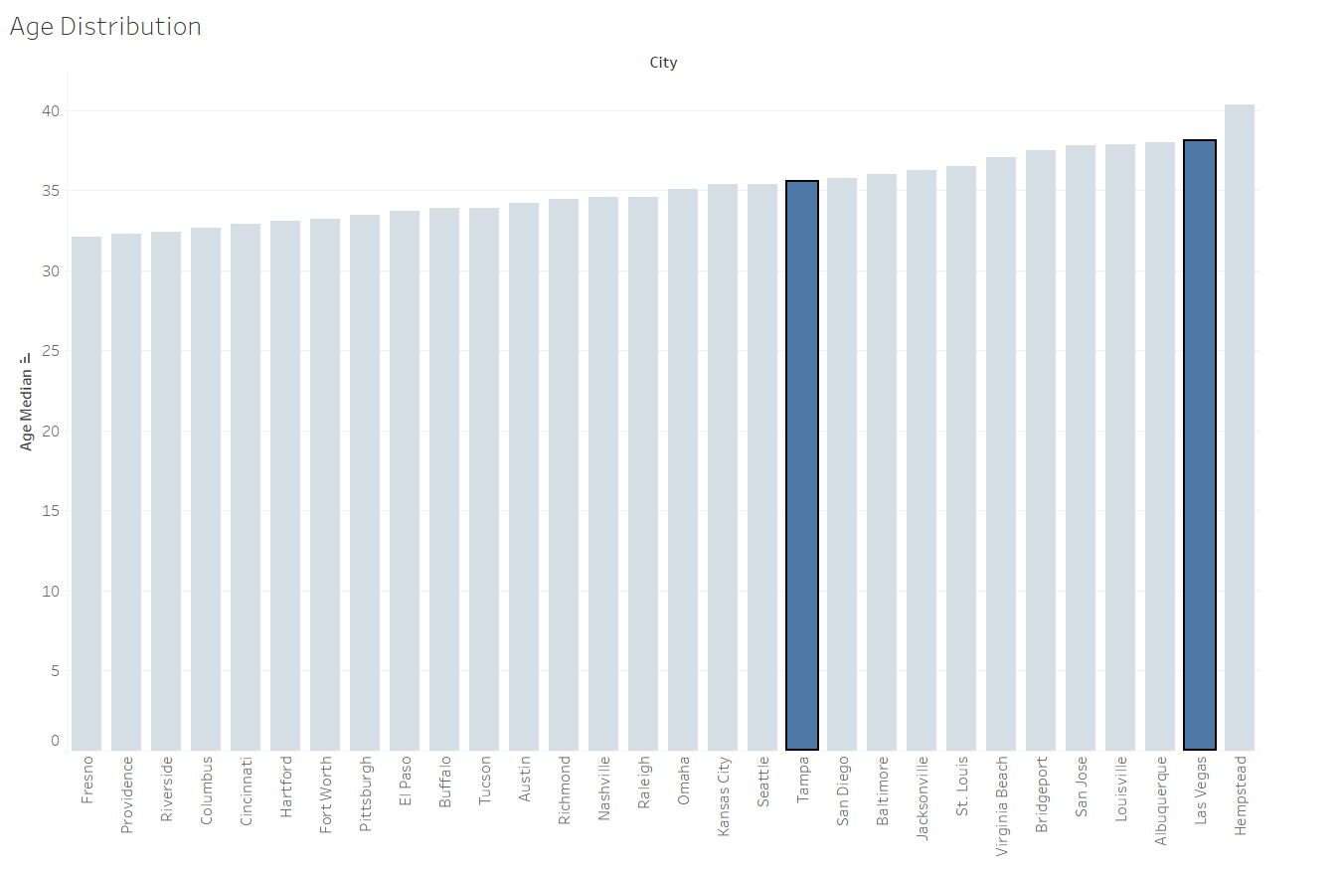
Age Distribution

Slide 41
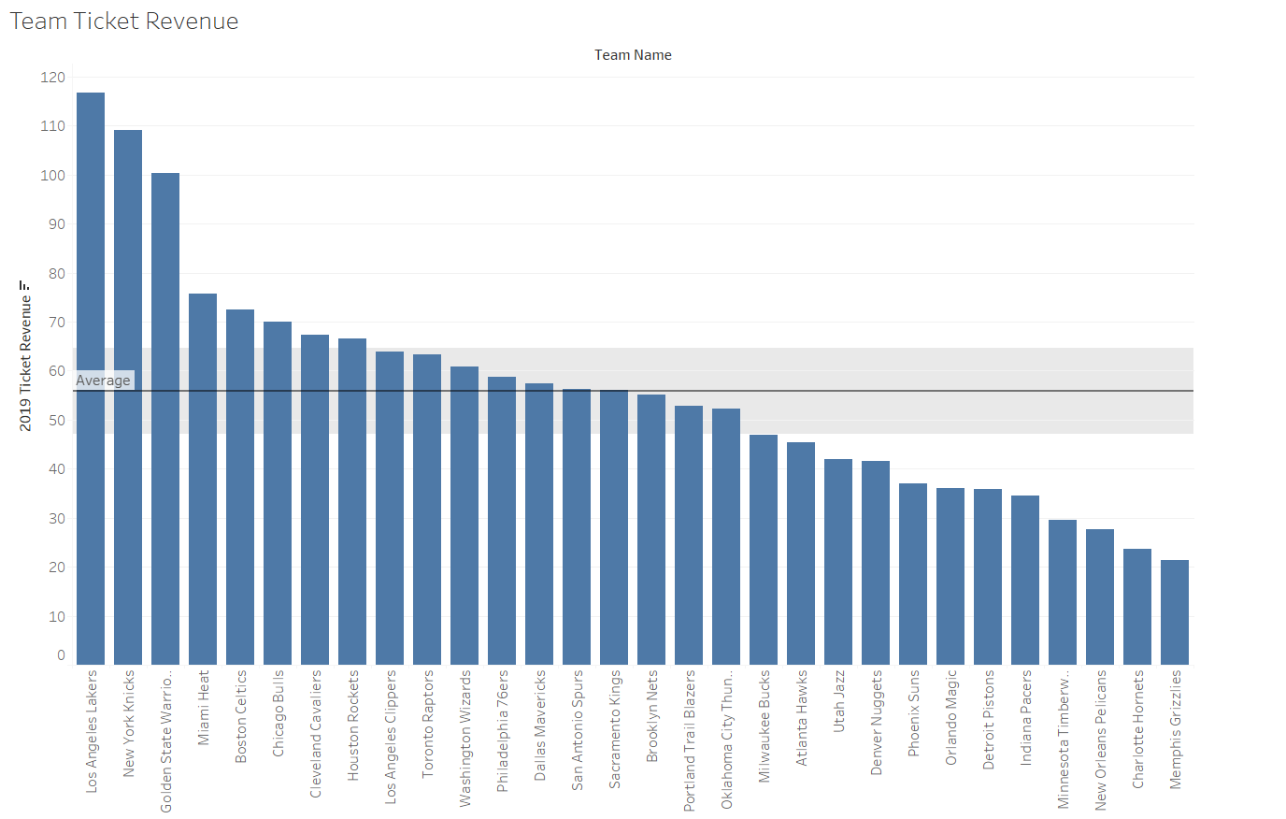
Team Ticket Revenue

Slide 42
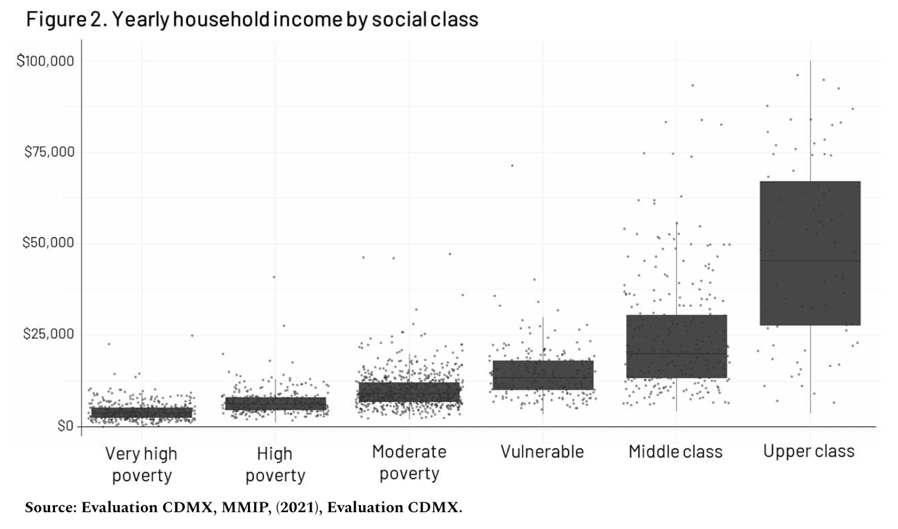
Targeting Mexico City’s Middle Class

Slide 43
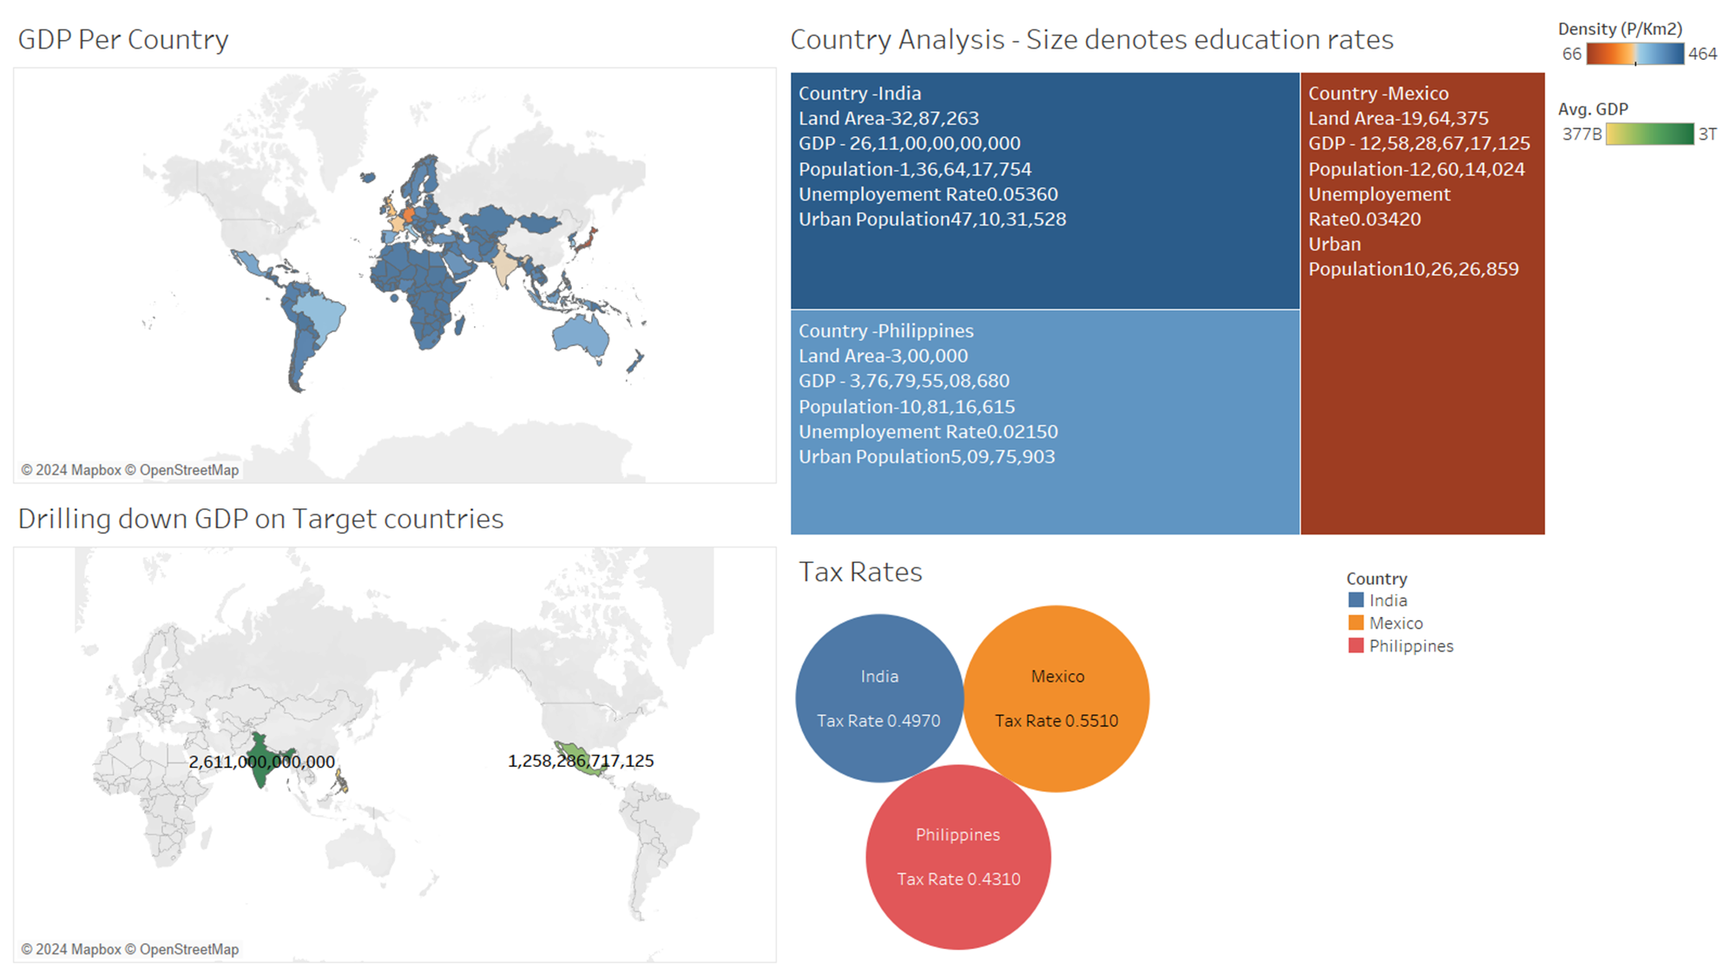
Why Mexico?
Notes:
Las Vegas (LV) to Mexico City:
Flight distance: Approximately 1,700 miles.
Time difference: Usually 2 hours behind Mexico City (considering standard time zones).
Tampa to Mexico City:
Flight distance: Around 1,200 miles.
Time difference: Typically 1 hour behind Mexico City (based on standard time zones).

Slide 44
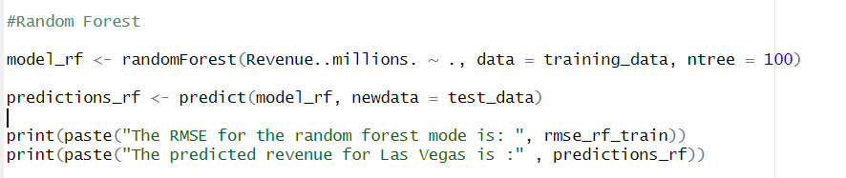
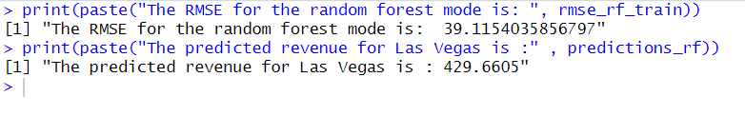
Random Forest Model Calculations

Slide 45

All Net Resort and Arena in Las Vegas
State of the art venue that will include;
Multi-Purpose 23,000 Seat Arena for Basketball and 25,000 seats for Concerts and Boxing
500-Room Five-Star Luxury Spa Hotel
300,000 square-foot Convention Center
World-Class Restaurants
12-Screen Luxury Movie Theater

Slide 46
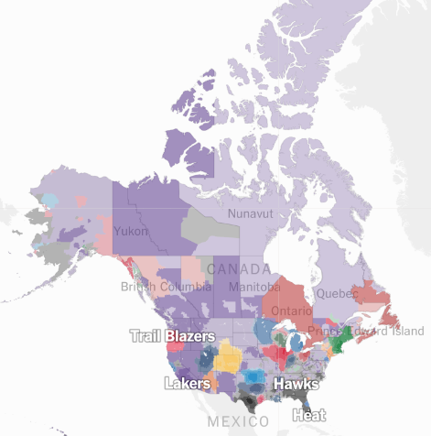
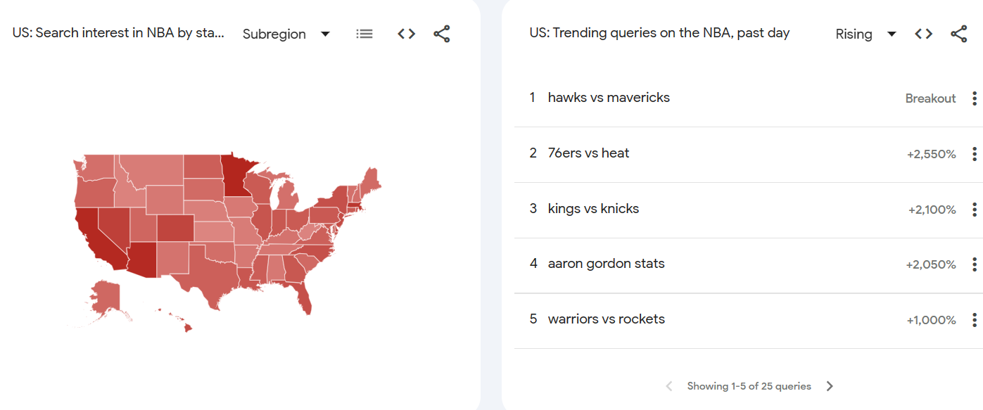
NBA Trends
NBA Fans in the US
‪‪NBA‬‬ - Google Trends
Which Team Do You Cheer For? An N.B.A. Fan Map - The New York Times (nytimes.com)

Slide 47
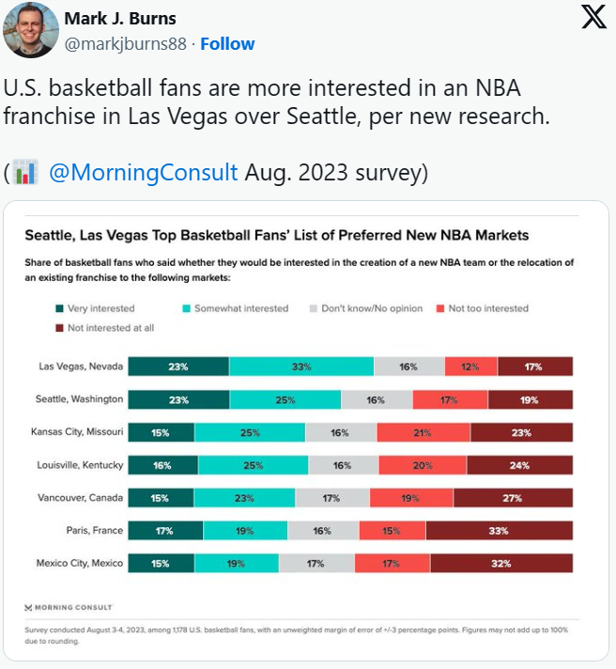
Expansion Cities - Reports
NBA Expansion
‪New report shows which cities NBA fans want the next expansion teams - TheStreet
5 Cities That Should Be Considered For An NBA Expansion Team (wrif.com)

Slide 48
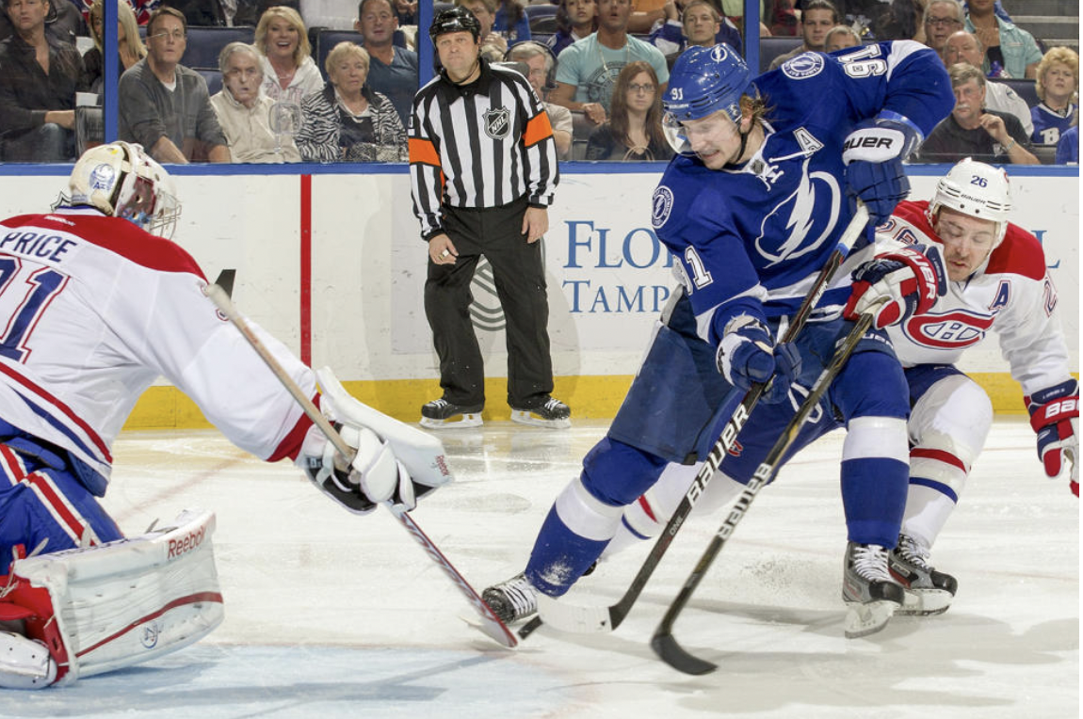
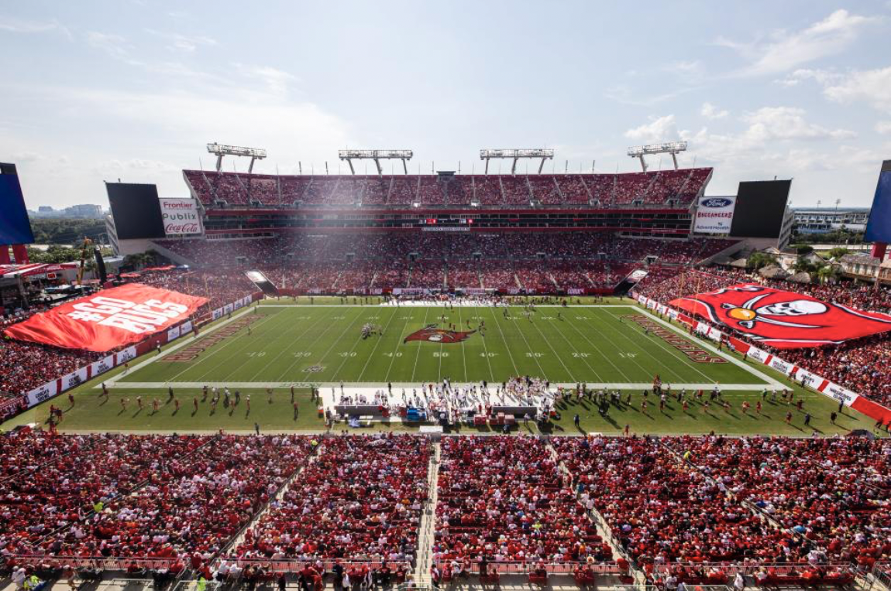
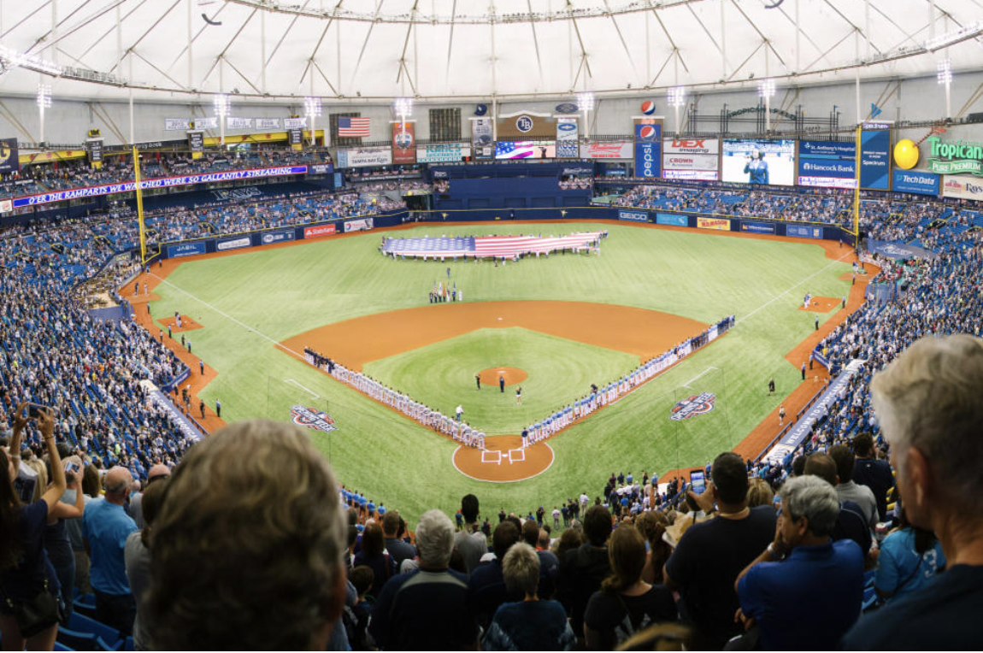
Culture: Embracing Tampa's Vibrant Sports Scene
Tampa Bay Lightning
Winners Stanley Cup 2020, 2021 and finalist 2022.
Tampa Bay Buccaneers
Superbowl Victory in 2021
Tampa Bay Rays
4 AL East Division Titles

Slide 49
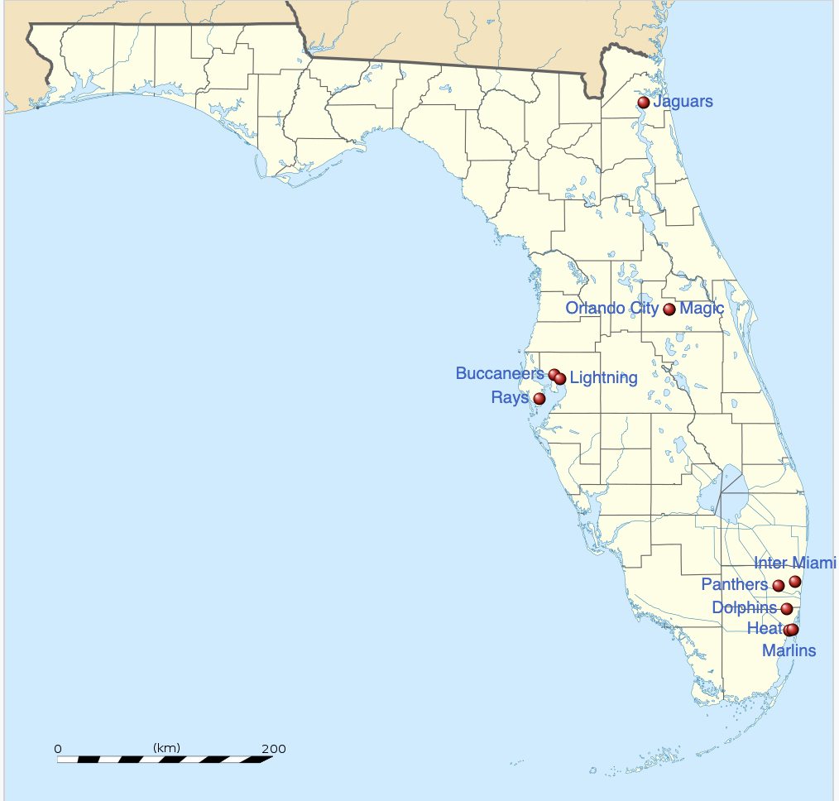
Culture: Embracing Tampa's Vibrant Sports Scene
Embracing Rivalry with Orlando Magic. Along with possible domination of west coast of Florida.
Major sporting teams in Florida

Slide 50
References for considering 6 criteria for shortlisting cities
Analysis
NBA Shortlisting Analysis – Code Crushers
Population, Income:
NBA Expansion and Relocation: The University of San Francisco
The 6 most Talked about cities for NBA Expansion - Sportsnaut
Age
Where could Pro Sports Expand? - OLBG
Affordability
https://www.valuepenguin.com/2017/02/affordability-every-nba-team-tickets *
Diversity:
NBA lauded for diversity practices, initiatives in report card by university - APNews
Culture and infrastructure
NBA Expansion 101– CBS News
Finding a City for the Next NBA Expansion Team – Bruin Sports Analytics

Slide 51
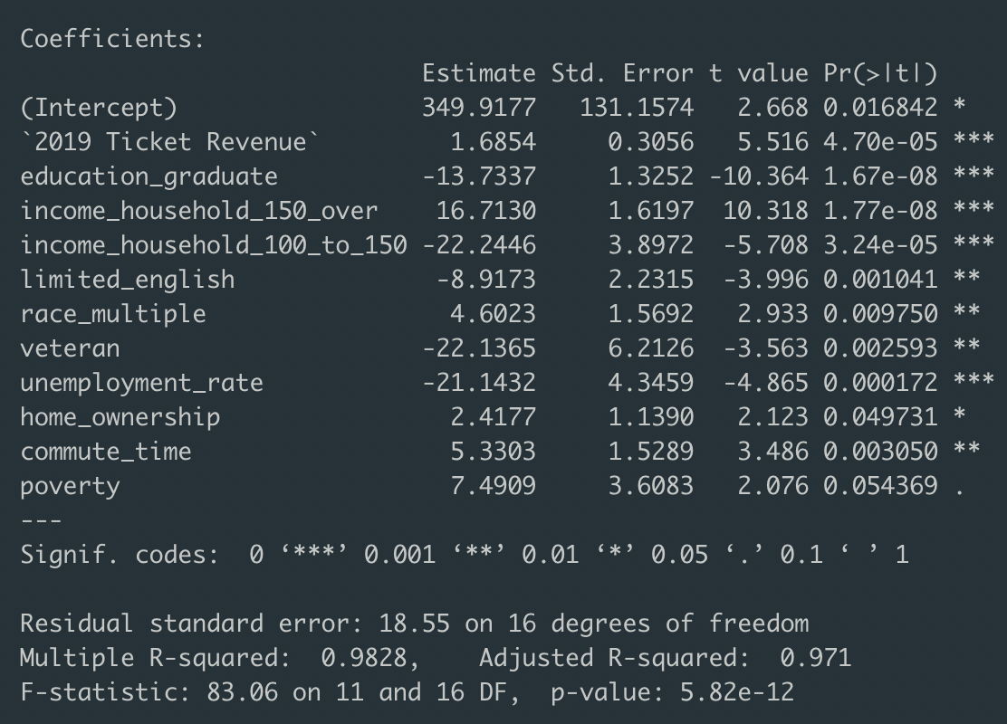
Regression model
Regression model for predicting the revenue of NBA cities by considering the variables in demographic data as well as 2019 ticket revenue sales

Slide 52
Las Vegas Revenue is similar to Phoenix Suns' revenue
Variables | Phoenix ($M) | Las Vegas ($M)
Revenue | 366 | 365
Density | 1198.9 | 1755.1
Age median | 34.4 | 38.1
Income household median | 72092 | 66356
Income household 100k to 150k | 16.9 | 16
Home value | 338432 | 363740
Rent median | 1322 | 1356
Poverty | 14.6 | 14.7
Commute time | 25.7 | 25.9

Slide 53
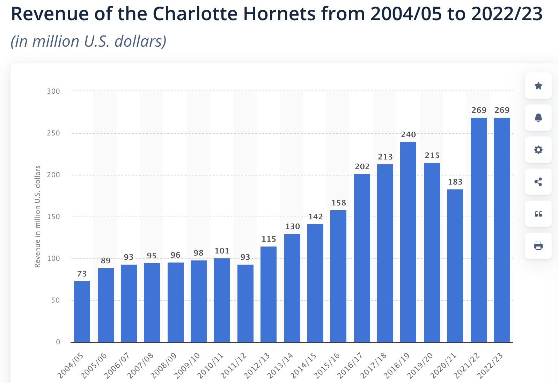
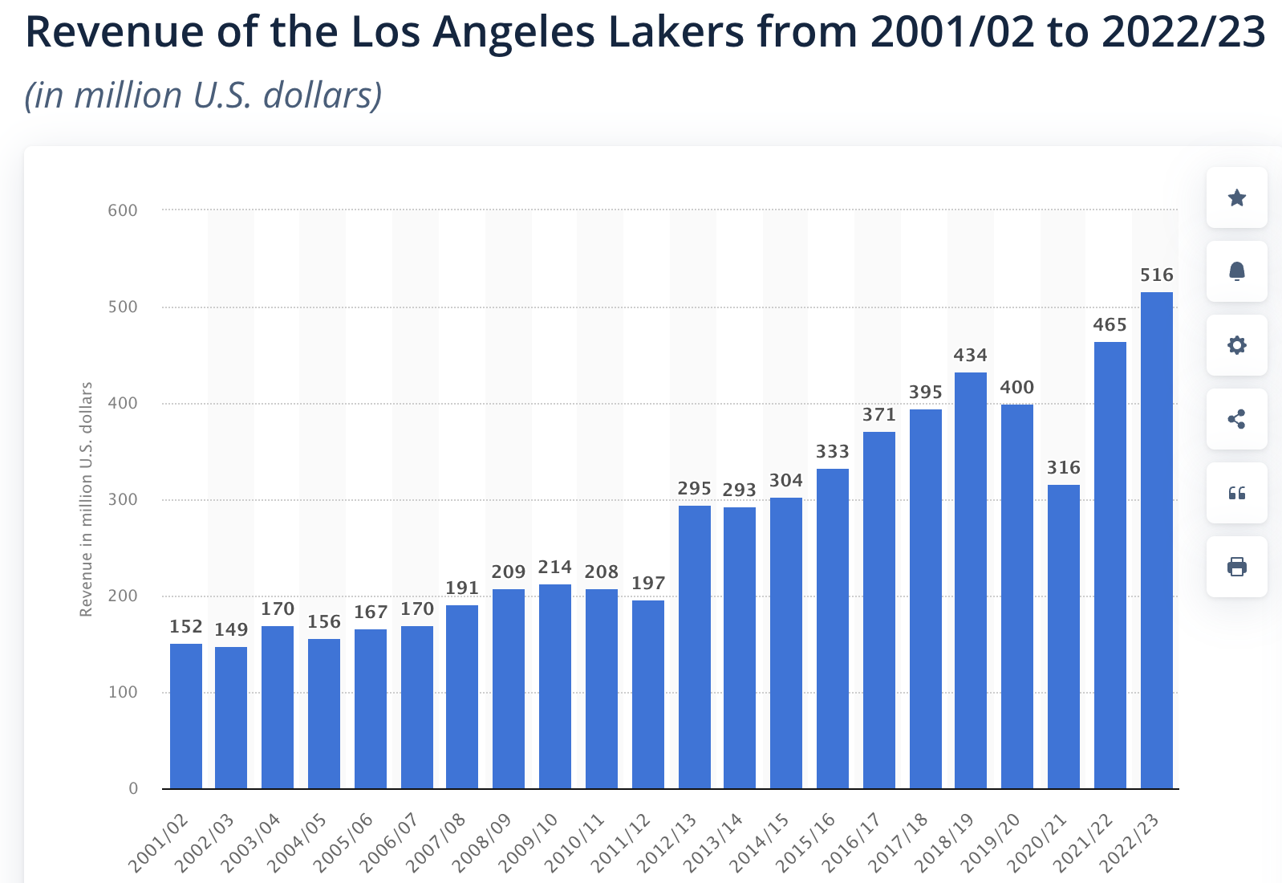
Charlotte Hornets and Lakers Annual Revenue Growth
Annual Growth: 14.21%
Annual Growth: 5.31%​
New Orlean Pelican's Annual Growth: 12.48%​

Slide 54
Financial Data - Sources
https://www.nbcsports.com/nba/news/adam-silvers-latest-comments-make-nba-expansion-seem-even-more-likely
https://www.si.com/nba/2018/09/21/nba-teams-revenue-spending-breakdown-small-large-market
https://law.marquette.edu/assets/sports-law/pdf/lease-summary-oklahoma-city-thunder.pdf
https://law.marquette.edu/assets/sports-law/pdf/lease-summary-indiana-pacers.pdf
https://www.techopedia.com/gambling/blog/top-5-highest-paid-coaches-in-the-nba-where-does-erik-spoelstras-120-million-extension-ranks
https://www.propublica.org/article/the-billionaire-playbook-how-sports-owners-use-their-teams-to-avoid-millions-in-taxes
https://theconstructionbroadsheet.com/charlotte-approves-m-for-nba-arena-upgrades-and-new-training-center-p925-174.htm

